Slide 1
SEGMENT 5:
PREPARING FOR SUCCESS
SCHOOL COORDINATOR TRAINING

Slide 2
UPDATE IMPORTANT ITEMS
Policies and Manuals
Faculty, Staff, Student, Crisis, HR, etc.
Foundational Documents
Mission, Vision, Expected Student Outcomes

Slide 3
CURRICULUM DOCUMENTATION
Reference Appendix B in the Standards Manual
All Subjects/Classes
Required Elements
Biblical Basis for Each Discipline
Biblical Integration
Learning Objectives
School-Selected Standards
Resources
Time Allotted
Evaluations/ assessment
Scope and Sequence

Slide 4
CURRICULUM DOCUMENTATION
Provide Clear Direction and Expectations for Teachers
Identify a Staff Person as a Point Person for Curriculum
Build a Continual Process Mentality – Living Document
Develop a Review Cycle for Curriculum

Slide 5
ASSESSMENTS
Reference Appendix C in Standards Manual
Collection of Data
Analysis of Data
Utilization of Data

Slide 6
SURVEYS
Reference Appendix B in the Standards Manual
Timeline is Important
Use a Comprehensive Survey
Response Rates
Staff – 60%
Students (at Least Middle School and Above – 40%
Alumni (Age-Appropriate Former Students) – 20%
Parents – 20%
Survey Options
FSCI
Cognia/ CCSA
School Developed – Reflect the Inspire Protocol
Analysis is a Key Component

Slide 7
FACULTY/ADMINISTRATOR QUALIFICATIONS
Four-Year Degree
School Based Professional Development Program (SBPD)
Review Updated Program Expectations on ACSI Website
Application Proccess
Replaces Certification Reporting
Certification
State or ACSI
80% Faculty
100% Administration
CPoE/Bible CEUs

Slide 8
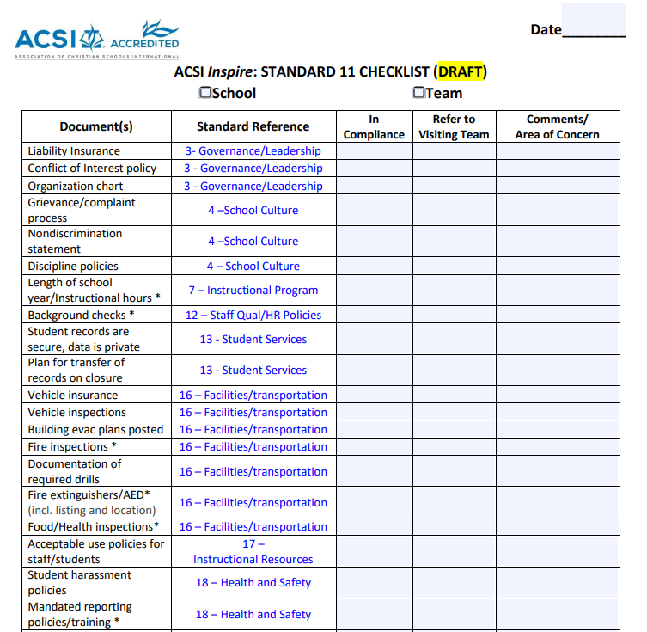
STANDARD 11 CHECKLIST

Slide 9
FINANCIAL REQUIREMENTS
Indicator 14.3
Various Levels of Financial Oversight Depending on Revenue
Done by Outside CPA

Slide 10
SEGMENT 5:
PREPARING FOR SUCCESS
SCHOOL COORDINATOR TRAINING

